Slide 1
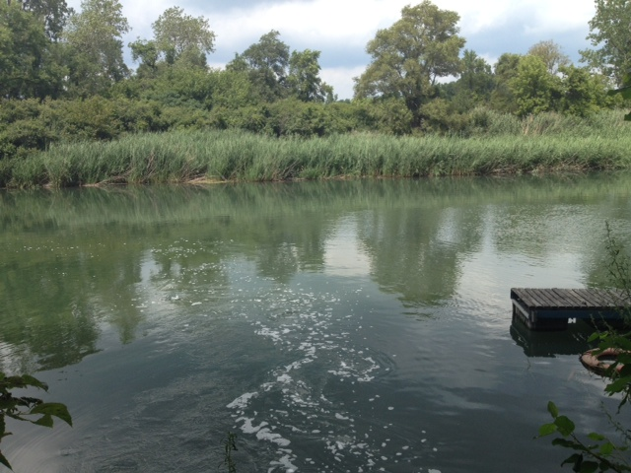
Gary Sanitary District What happens when you flush?
Open House August 9, 2013

Slide 2
Where does the water go when you flush the toilet?

Slide 3
What happens to the water that goes down the drain when you take a shower?

Slide 5
Where does the water go when it rains?

Slide 6
It’s our job to protect the environment!
Notes:
All the water that goes down the drains in your homes and the stormwater that goes down the sewers goes to a wastewater plant such as this one where the water is treated and discharged into to the Grand Calumet River. All the water on earth is all that will ever be on earth, and it is our job to treat it so that we do not pollute natural waters. Our main job is to protect the environment.

Slide 7
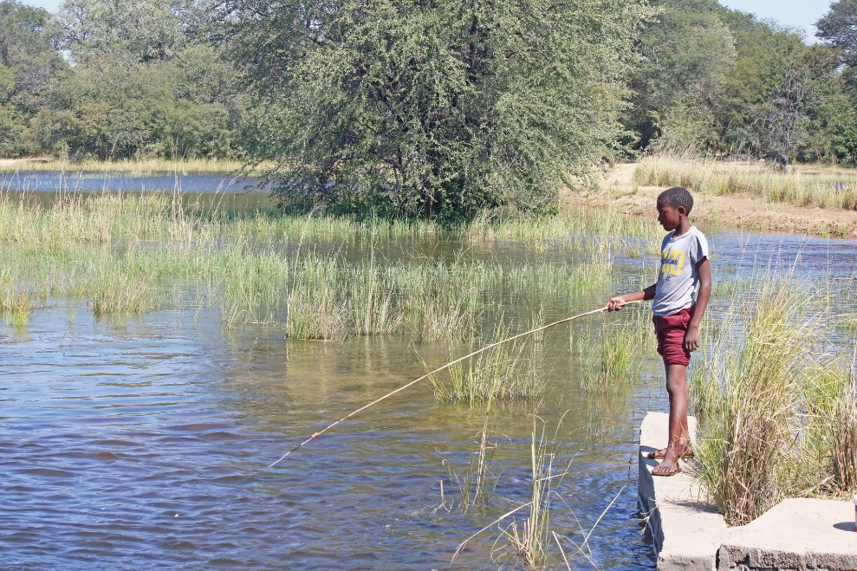
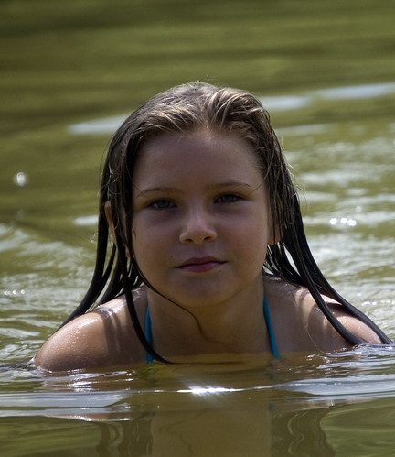
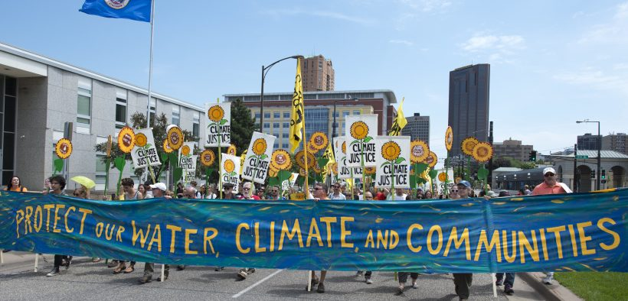
We also protect the public’s health too! That means you!
Notes:
All the water that goes down the drains in your homes and the storm water that goes down the sewers goes to a wastewater plant such as this one where the water is treated and discharged into to the Grand Calumet River. All the water that is on earth is all of the water that will ever be on earth and it is our job to treat it so that we do not pollute natural waters. Our main job is to protect the environment.

Slide 8
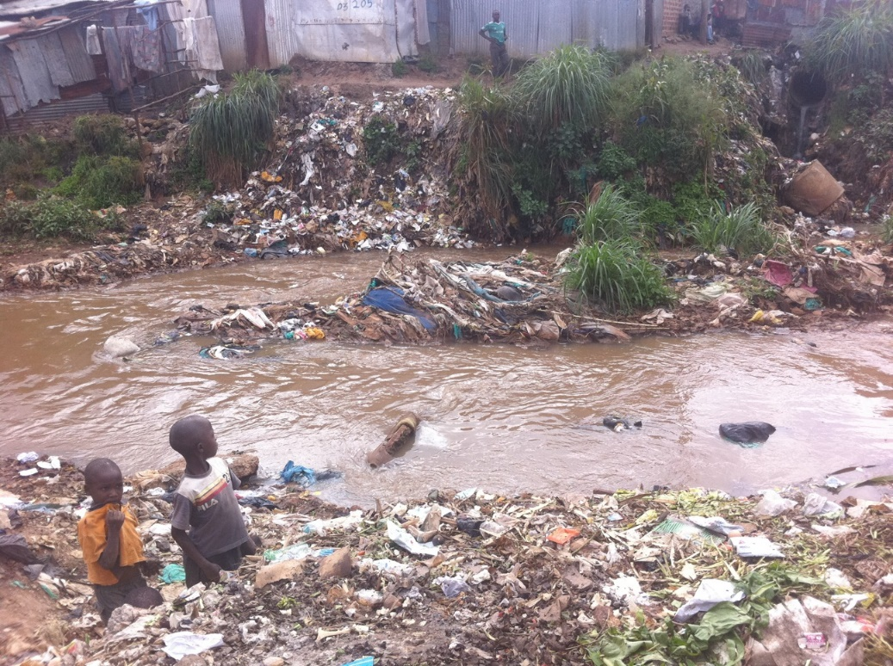
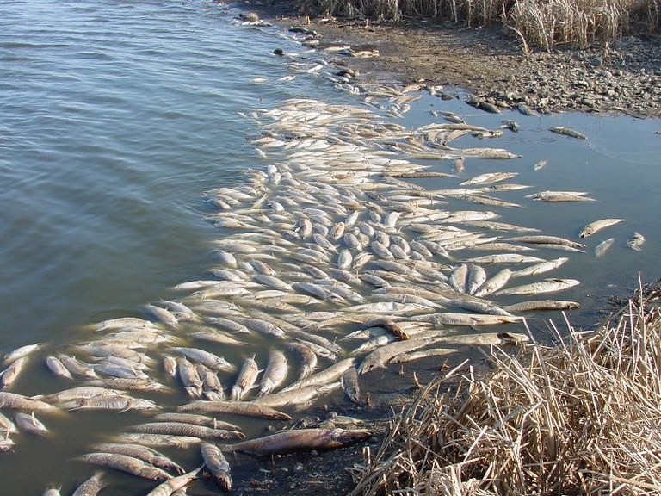
What happens if we don’t treat wastewater?

Slide 9
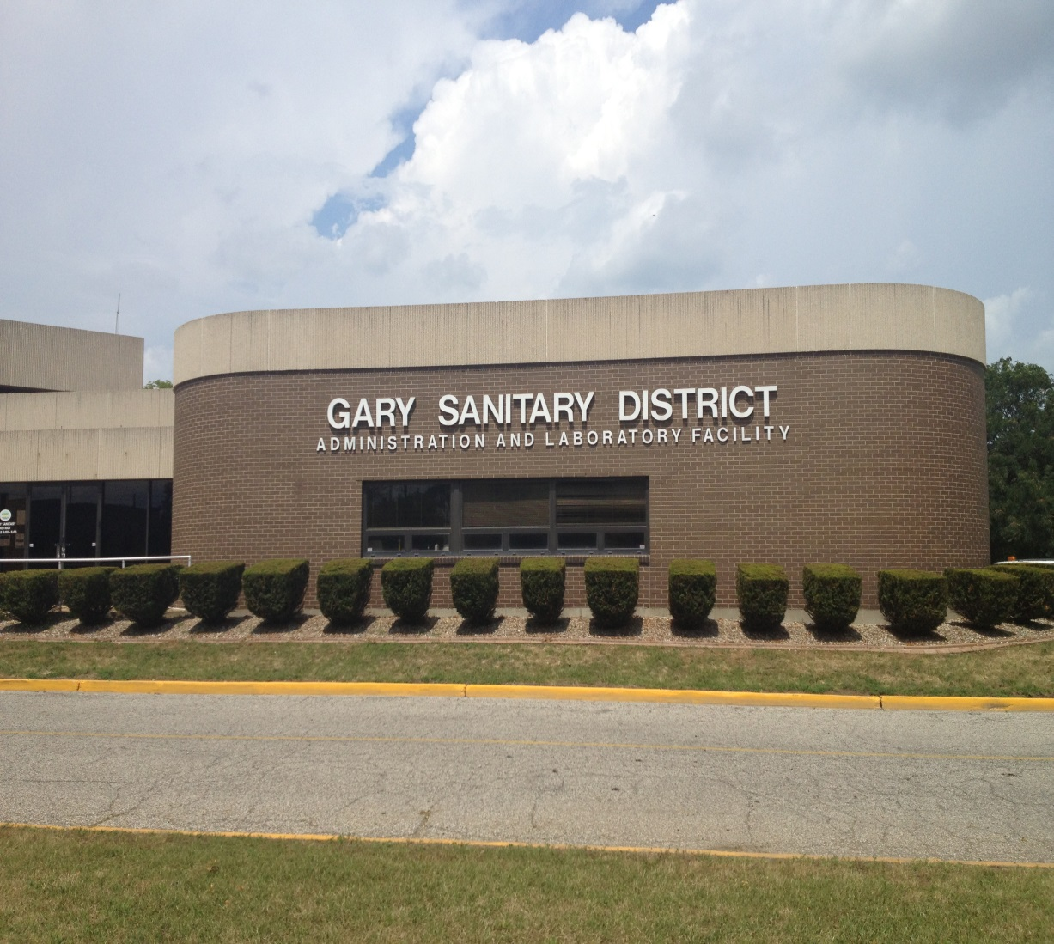
GSD provides service to Gary, Hobart, Merrillville, and Lake Station through over 400 miles of sewer.
On average, GSD treats 40 million gallons of water per day. During a rain event, the flow rate may be as high as 150 million gallons per day.

Slide 10
.
IDEM NPDES Permit
Pollutants Effluent limits
Consequences on non-compliance
Permit Renewal
Notes:
The United Stated Environmental Protection Agency (USEPA) Indiana Department of Environment Management (IDEM) requires a National Pollutant Elimination Discharge (NPDES) permit to be able to discharge into natural waters. The permit provides limits for a list of pollutants that we must test for and there are consequences if we do not. The permit must be renewed every 5 years.

Slide 11
Notes:
If protecting the environment isn’t incentive enough, there may be fines if we discharge water that does not meet or is better than effluent limits. In extreme cases waste water employees have been jailed for falsifying data or knowingly neglecting to utilize available resources to prevent effluent limit excursions.

Slide 12
GSD WWTP
Notes:
Here’s an overview of the plant. We’re in this room (point to board room)

Slide 13
Trash Rack
Preliminary Treatment
The track rack, bar screens, detritus tanks, and grit washers remove large objects to prevent damage to pumps and other equipment.
Notes:
Preliminary treatment consisting of the trash rack, bar screens, detritus tanks, and grit washers is 1st. Here’s a picture of the trash rack that has spacing that are 2” parts restricting anything larger from that from entering the waste stream. After that the bar screens prevent anything larger than ¼” from passing through. The grit washer separates and removes grit (gravel, sand, materials that are ground up in garbage disposals in your homes) from the waste stream to protect our pumps and other equipment.

Slide 14
Primary Treatment
Ten primary clarifiers remove about 50% of suspended solids, 30% of BOD, 30% of phosphorus, and 1-2% of ammonia, by slowing flow to allow substances heavier than water to settle to the bottom and substances lighter than water to rise to the top.
Notes:
What is BOD: BOD (biological oxygen demand): represents the amount of oxygen consumed by bacteria and other microorganisms while they decompose organic matter under aerobic (oxygen is present) conditions at a specified temperature. Directly affects the amount of dissolved oxygen in rivers and streams. The greater the BOD, the more rapidly oxygen is depleted in the stream. This means less oxygen is available to higher forms of aquatic life.

Slide 15
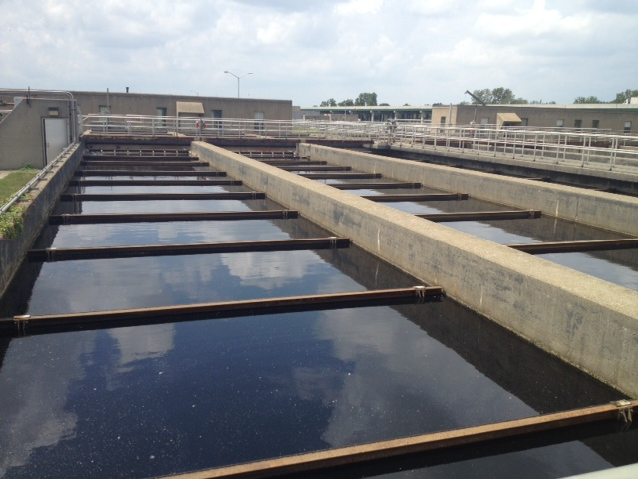
GSD has eight square and two rectangular primary clarifiers.
Notes:
Here are pictures of the 2 kinds of primary tanks that we have. Both have rakes that skim pollutants off of the top and bottom of the tanks.

Slide 16
c
Secondary Treatment
Biological Treatment removes dissolved and suspended organic solids that remain in the wastewater. Bacteria are said to be the hardest workers in a wastewater plant and they utilize solids as a food source in the aeration tanks and then settle out in the secondary clarifiers. After secondary treatment, about 99% of ammonia, 97% of BOD and suspended solids, and 87% of phosphorus has been removed.

Slide 17
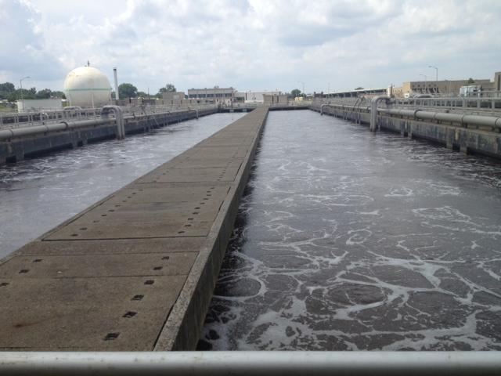
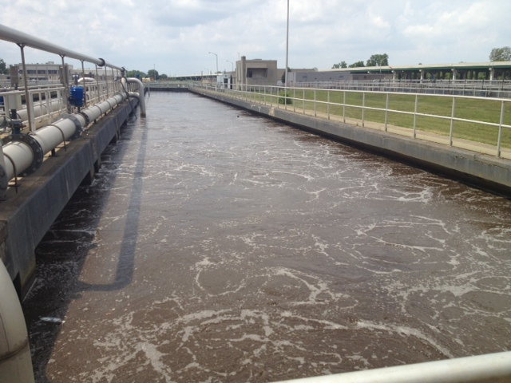
GSD has six aeration tanks where air is added to help the bacteria thrive.

Slide 18
There are 24 secondary clarifiers which settle dissolved and suspended solids
Most of the solids are returned to the aerators as “Returned Activated Sludge” or RAS. Excess solids are wasted. In other words, removed from the waste stream.

Slide 19
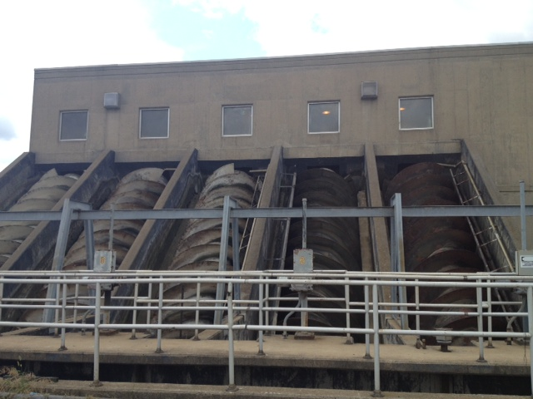
Tertiary Treatment
Filtration is the polishing step which removes remaining fine suspended solids. Screw pumps (shown on the right) convey water from the secondary clarifiers to the filters.

Slide 20
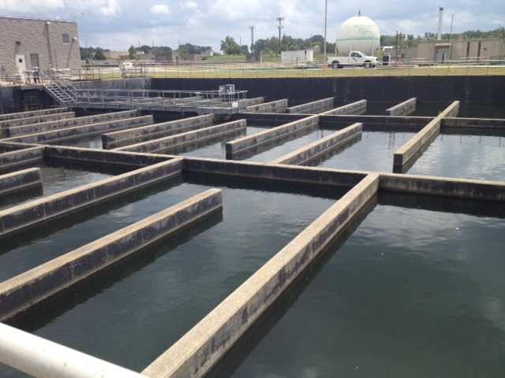
Chlorine Contact Chamber
Chlorination/de-chlorination is the last step. First, the water is chlorinated to inactivate E. coli. Then the water is de-chlorinated prior to discharge into the Grand Calumet River.
Notes:
What product is used at home to disinfect or to whiten your clothes? Well, we use bleach as well to reduce the concentration of e. Coli in the water to be discharge into the river. However, we can’t discharge chlorinate into the rive so we have to add another chemical to neutralize the chlorine so that we don’t kill fish and other aquatic life.

Slide 21
Outfall
The finished product is treated water that is environmentally safe.

Slide 22
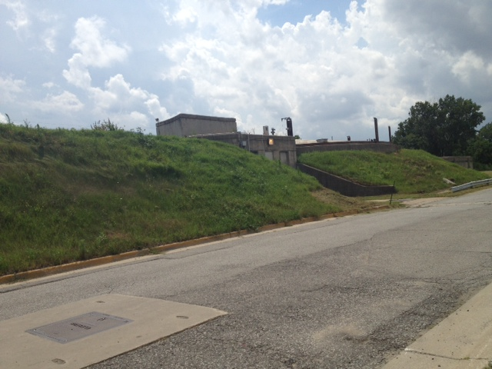
Solids Handling
The resultant solids that are produced during primary and secondary treatment are collected and thickened. They are then pumped to anaerobic digesters where bacteria use the organic material as a food source. The methane that is produced in this process can be used as fuel in the digester boilers.
Notes:
I’ve talked a lot about removing solids from the waste stream and perhaps you’re wondering what happens to them.

Slide 23
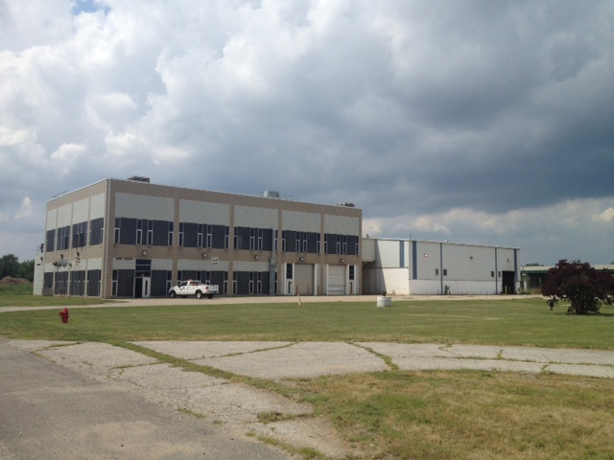
Digested solids are dewatered in the dewatering building and hauled to a landfill.

Slide 24
Operations
Maintenance
Notes:
As you might guess, it takes a lot of teamwork to make this happen, Operators work 24/7 on 12 hour shifts ensuring that the plant runs as designed and make adjustments as needed. The maintenance staff perform preventive and corrective maintenance on our equipment. In addition, there’s a Collections department who keep the streets clean so that debris doesn’t wash into the sewers when it rains. Other Collections department employees televise sewers to look for problems so that they can be corrected. Our laboratory test the water for us which helps us to make treatment decisions. We also have an Engineering department who oversee our larger projects, accountants who make sure our employees and bills get paid, and Human Resources Department who oversee such administrative tasks as hiring, managing our benefits and other tasks. Collectively, w work towards the common goal of protecting the environment.

Slide 25
Notes:
Are there any questions?

